Slide 1
Student Database Handling using Face recognition technic
Project members
Introduction of project
Aim of the project
Scope of project
What technology or programming language is used in project
Functions/working of project
future updates and scope

Slide 2
PROJECT MEMBERS
Nagdatt Gajjam(group leader)
Sumit Shinde
Abhijit kore
Vipul Sanga

Slide 3
INTRODUCTION OF PROJECT
“Student Database Handling using Face recognition technic” is mainly created for give more efficiency in students attendance (Using face recognition algorithm in python ) and store students data automatically in excel files and increase the speed of website. In this website we can easily understand the current situation of our colleges attendance. Student under 70% attendance can get alert mail to their parents too.

Slide 4
AIM OF THE PROJECT
To Easier to handle Student attendance records
Easy to work and beautiful UI , Responsive Ui
maintenance should be done easily
Should adapt future updates easily

Slide 5
Scope of project
Since this project is for college this software is more secure ,and this website can access only college staff and Head of department . we divided staff and HOD’s data into 2 panels and given more accessibility to HOD. Manual changes can be done by Admin. Statistics can as hard copy cause we have given print out facility.

Slide 6
What technology or programming language is used for project
Front End | Back End
Html/CSS/ Javascript | Python
Bootstrap (V 4.5) | Php
Admin Lte. (v 3.0.4) | MySQL

Slide 7
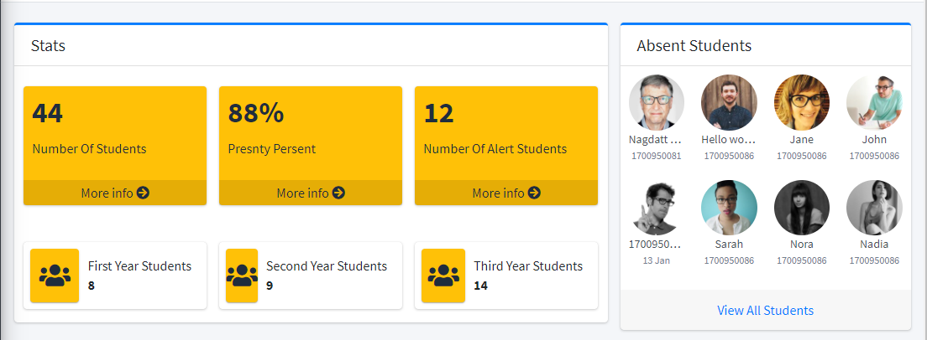
Functions / working of project/Output 1.dashboard

Slide 8
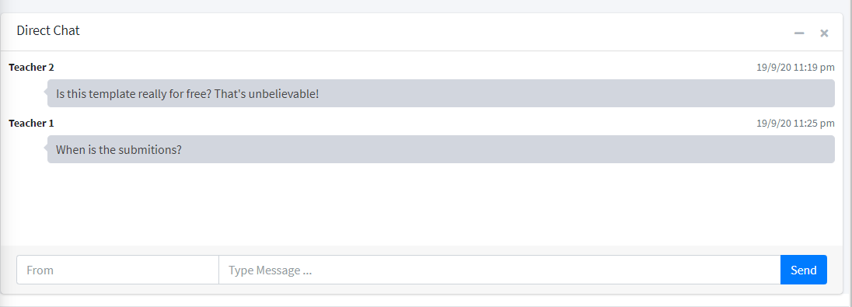
2.Direct Chat

Slide 9
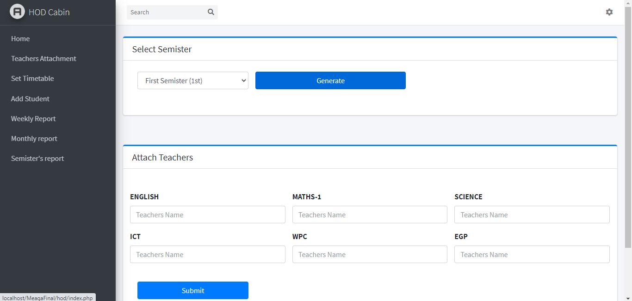
3.Teacher attachment

Slide 10
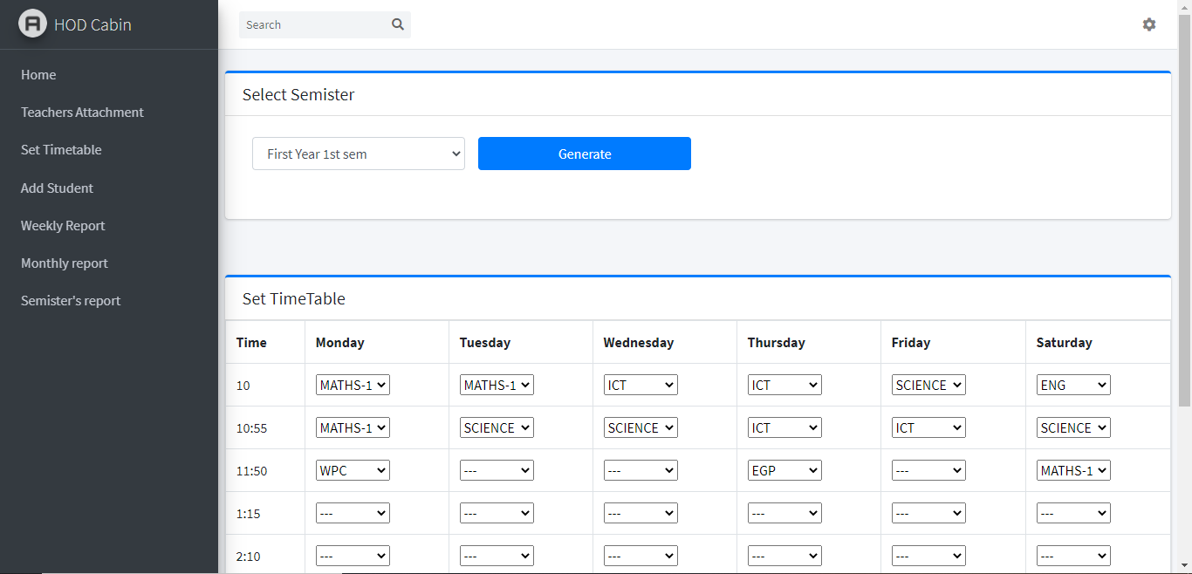
3.Timetable generation

Slide 11
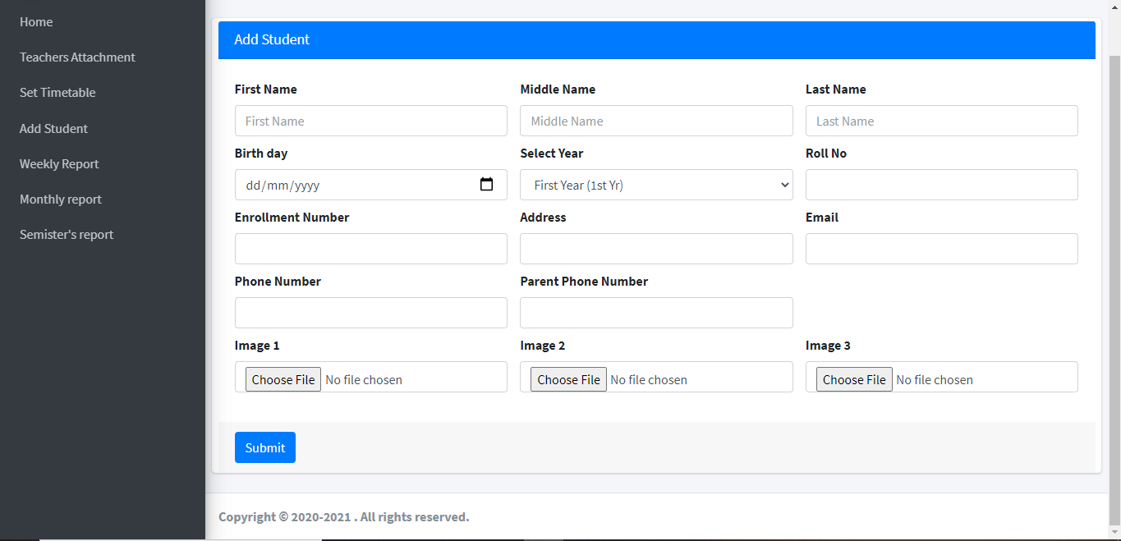
4.Add student

Slide 12
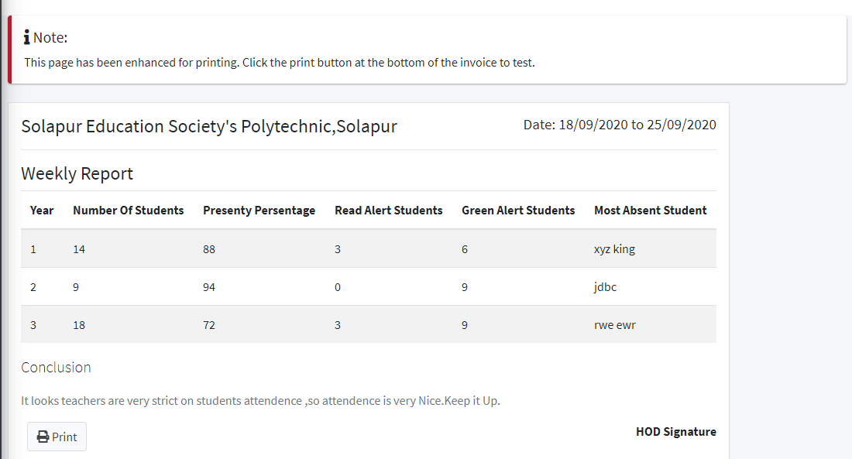
5.reports

Slide 13
Features of project
Attend student presenty using Face recognition
Teachers can analyse students attendance data between weeks , moths , semesters
We can see current lectures attendance
We provide excel files to see static records

Slide 14
Future updates and scope
Elaborate more analytical data that can help teachers to analyse particular student.
Calculate student chart(based on their mood)
Increase the speed of attendance and create some threads to increase the speed of performance
Increase the contents of our website

